Slide 1

Presentation
Paul Hulsbosch
Notes:
Goodmorning. My name is Paul Hulsbosch and I am a teacher at the Summa college in Eindhoven, a city in the South-East of the Netherlands. I teach anatomy, physiology, pathology and nursing at Summa nursing school. Besides that, I am also currently involved within the Summa engineering for society track. These next few minutes I would like to introduce to you the Summa college, and tell you more about vocational education in the Netherlands.

Slide 2
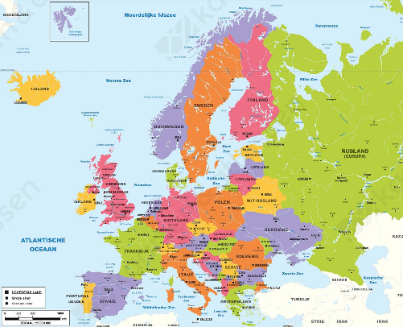
Notes:
Summa college is a regional educational centre located in the South of the Netherlands.

Slide 3
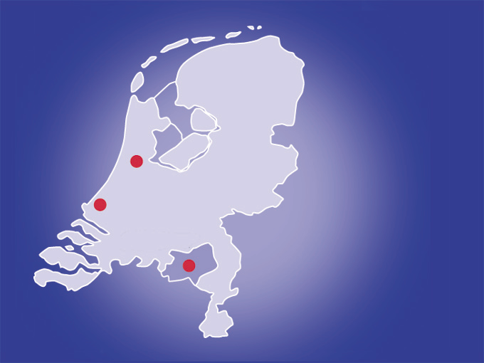
Amsterdam
The Hague
Eindhoven

Slide 4
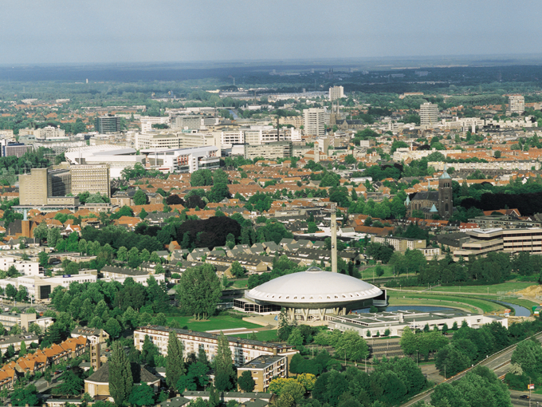
Notes:
This region is also known as Brainport Eindhoven.

Slide 5

Notes:
Brainport is a leading technology region in Europe. Located in the South-East of the Netherlands with Eindhoven at its heart.
This region is very well-known for its cutting edge technological research, and it strives to find solutions for the societal challanges of tomorrow.

Slide 6
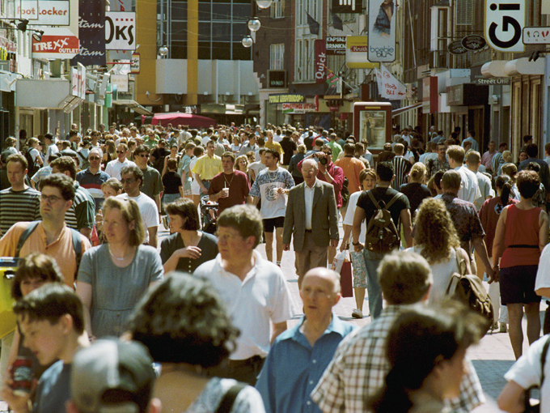
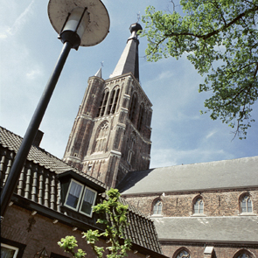
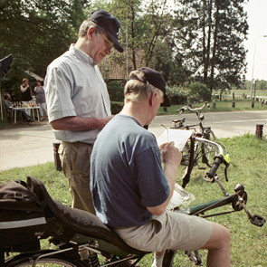
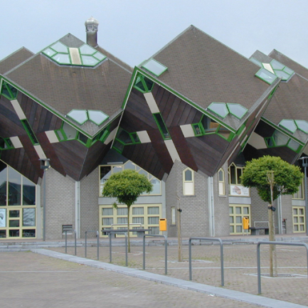
Notes:
The Brainport region has a population of 700.000 people, of which 350.000 are employed within several different sectors.
One of these sectors is healthcare.

Slide 7
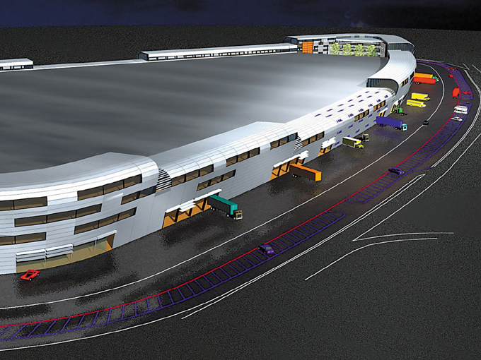
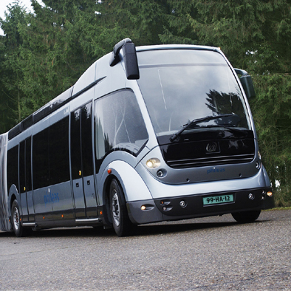

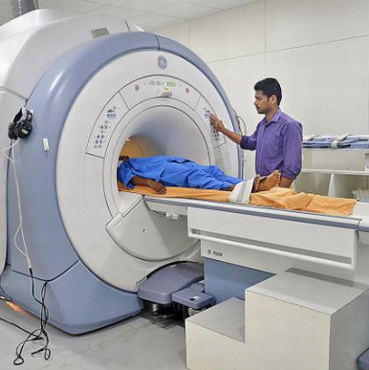

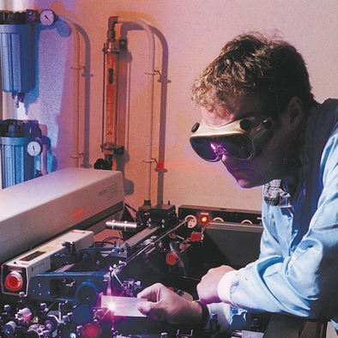
Notes:
The most important sectors are
electro-technology,
mechatronics,
automotive,
medical technology,
ICT, and
healthcare.

Slide 8
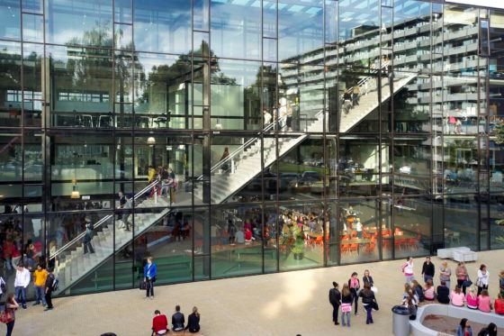
Notes:
Summa college is the most important educational centre that provides vocational training within the brainport region.

Slide 9
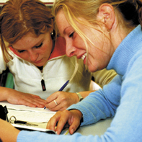
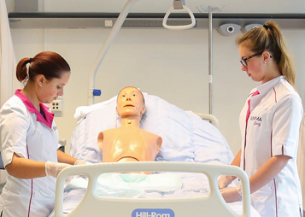
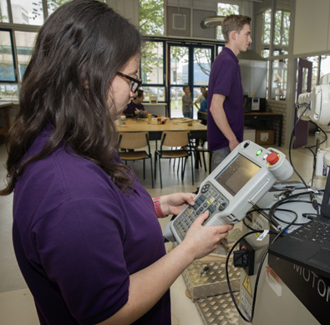
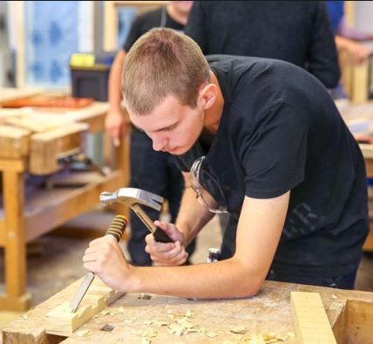
Schools
17 schools for vocational education
1 school for adult education (Ster College)
1 secondary school (Montessori College)
17,000 students in regular education
Staff of 1,300
Annual turnover of € 130 million
Notes:
Summa college is a large instution: it has
17 vocational colleges,
1 college for adult education,
1 secondary school (montessori),
it caters to 17.000 students,
has a staff of 1300, and an
annual turnover of 130 million euros.

Slide 10
Transport & Logistics
Technology Mechanical/electrical/installation Engineering
Structural Engineering & Building Trades
Welfare, Culture & Education
Woodwork, Furniture & Interior Decorating
Automotive Branch
Beauty Care & Hairdressing
Bread & Pastry-making
the Care Sector
Commerce & Marketing
Economics
ICT
Electronics & Electrical Engineering
Fashion
Notes:
will now list some examples of the different vocational education tracks that Summa college offers:
Transport & Logistics
Technology Mechanical/electrical/installation Engineering
Structural Engineering & Building Trades
Welfare, Culture & Education
Woodwork, Furniture & Interior Decorating
Automotive Branch
Beauty Care & Hairdressing
Bread & Pastry-making
the Care Sector
Commerce & Marketing
Economics
ICT
Fashion

Slide 11
Vocational education in the Netherlands
two pathways:
fulltime course
dual course (working & learning)
four levels EQF (European Qualification Framework): 1 (assistent) 2 (skilled worker) 3 (professional) 4 (middle management or specialist)
Notes:
I will proceed by further explaining how vocational education is structured in the Netherlands.
A student has two options: he or she can either
study full-time, or do
a duel course (working and learning).
These two tracks are divided in 4 levels, according to the European Qualification Framework.
Level 1 is assistant
Level 2 is skilled worker
Level 3 is professional
Level 4 is middle management or specialist
(dit zou ik nog als afsluiting doen)
Thank you for your time and attention.
At last i will show you a short videi of the schoolsystem in the Netherlands.
Video van het onderwijssysteem

