Slide 1
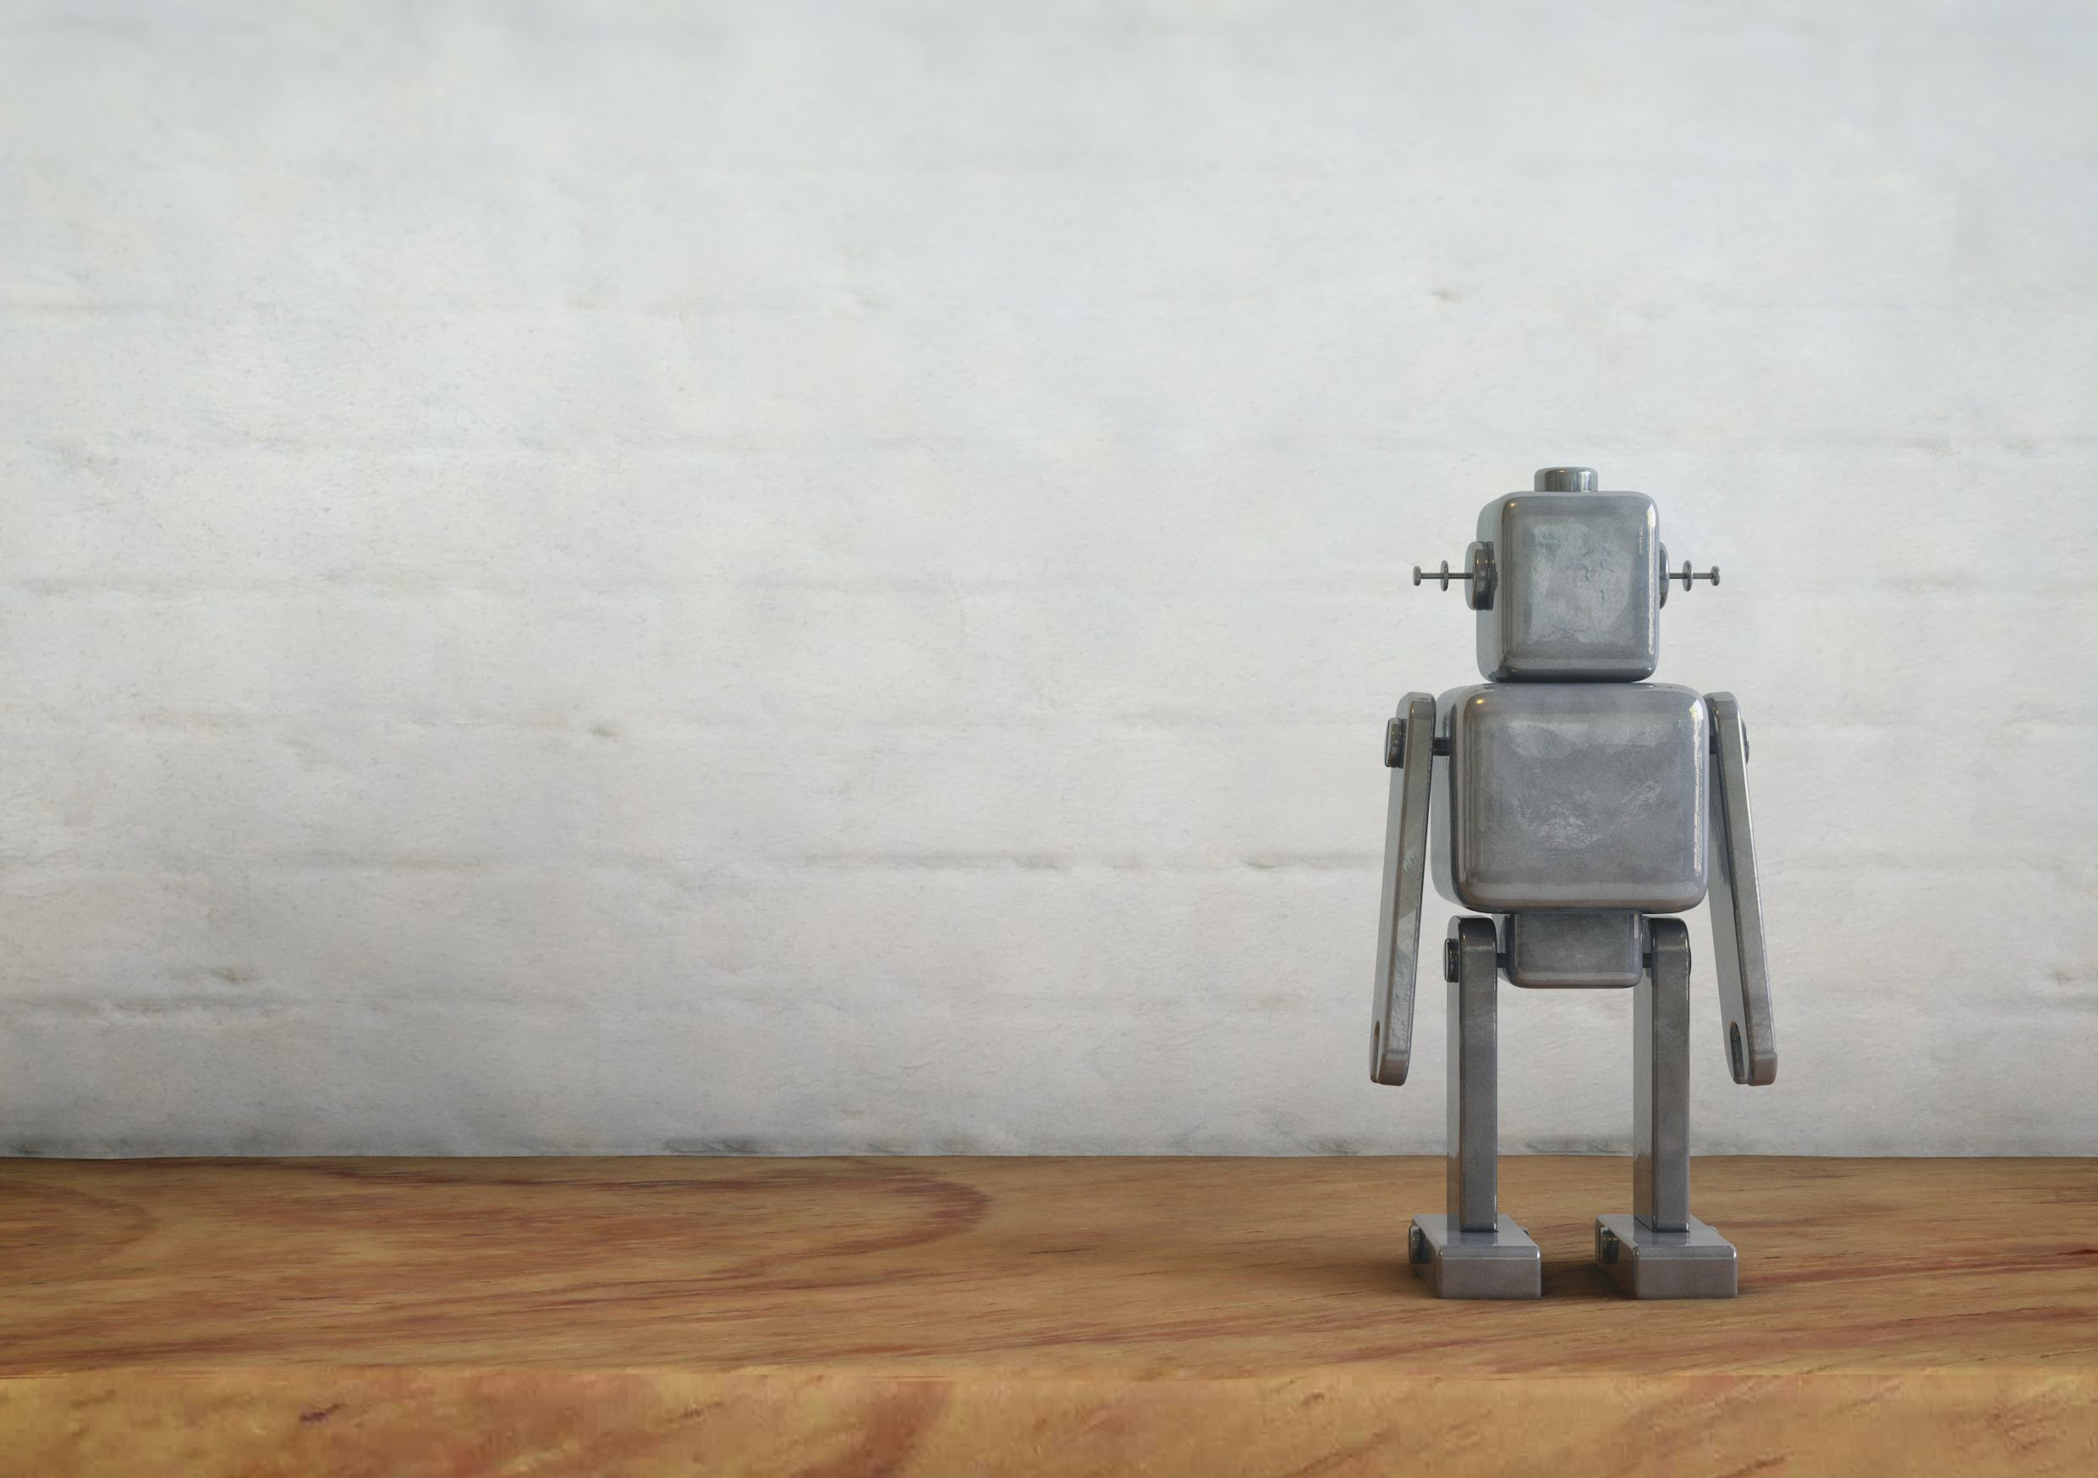






What do you know about robotics in healthcare?
Play the quiz!
The quiz was made for the project ‘Workplace Meaningful Robotics in Healthcare’ by Vilans, Windesheim, commissioned by ZonMW and SIA

Slide 2


Introduction
Technological developments are taking place at lightning speed and healthcare organizations are increasingly considering the use of robotics. How much do you know about robotics so that you can use it meaningfully in your work? Play the quiz.
The quiz has been created as part of the Care for Better Workplace for Meaningful Robotics in Healthcare, take a look at www.zorgvoorbeter.nl/robotica

Slide 3
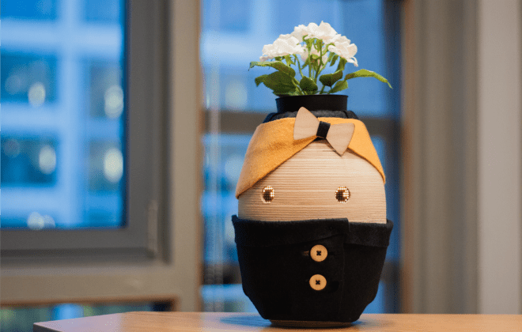
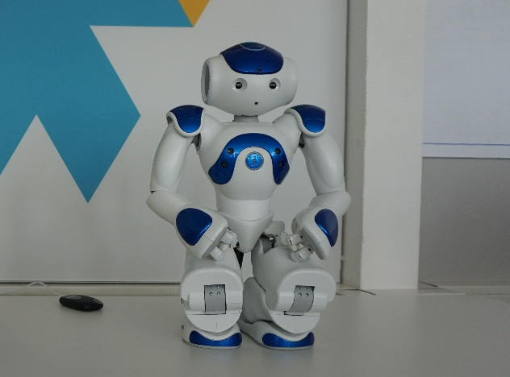
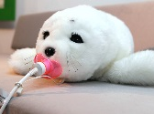
1
Your client becomes more and more forgetful and cannot perform actions as well. Which robot would be the most suitable for meaningful use with your client?
Robot Tessa Robot Zora Robot Paro
A
B
C

Slide 4


A
Good! "I am Tessa and I can help your client through my agenda function. Healthcare professionals and family members can enter agenda items that I speak out loud at the scheduled time. Give me WIFI and power and then I help to remind your client. In addition, I can also explain how to make a cup of coffee! '
Tip: think about the privacy of your client. Tessa will speak out the memories, also when someone is visiting.

Slide 5
2
What do you pay attention to before you use a robot with the client?
A
It is important to think carefully with wich goal we want to use the robot. Of course, the cost factor also plays a role here.
I turn on the robot that we have left. It is a shame if it stays on the shelf.
I pay attention to the goal with which we want to use the robot, but there are many different aspects that you have to take into account. This differs per robot, client and setting.
B
C

Slide 6

C
That’s completely right! For each situation you look at the target, the financing, the hygiene regulations, the conditions of the supplier, the opion of the client and informal carer, the maintenance, safety and the ease with which the robot can be deployed.

Slide 7
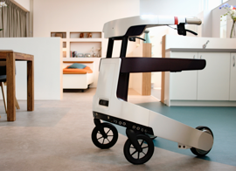
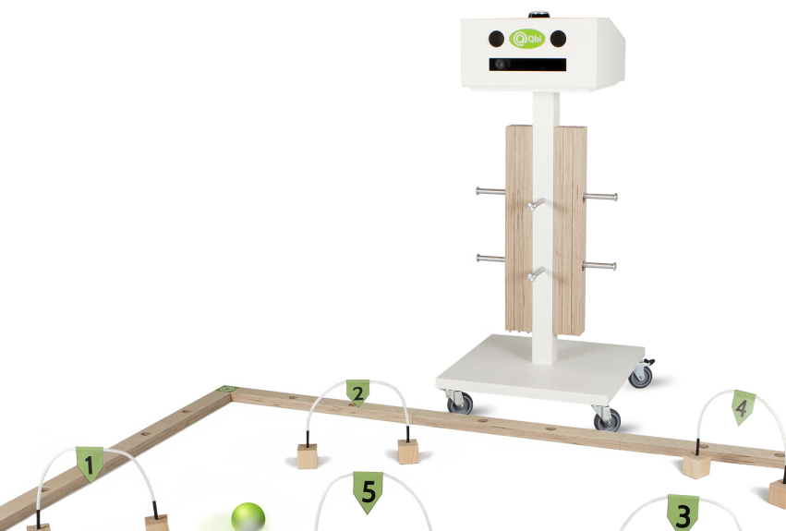
3
Suppose you want to encourage your clients to move more in groups. Which robot do you choose?
Robot LEA Robot Zora Robot Qbi
A
B
C

Slide 8

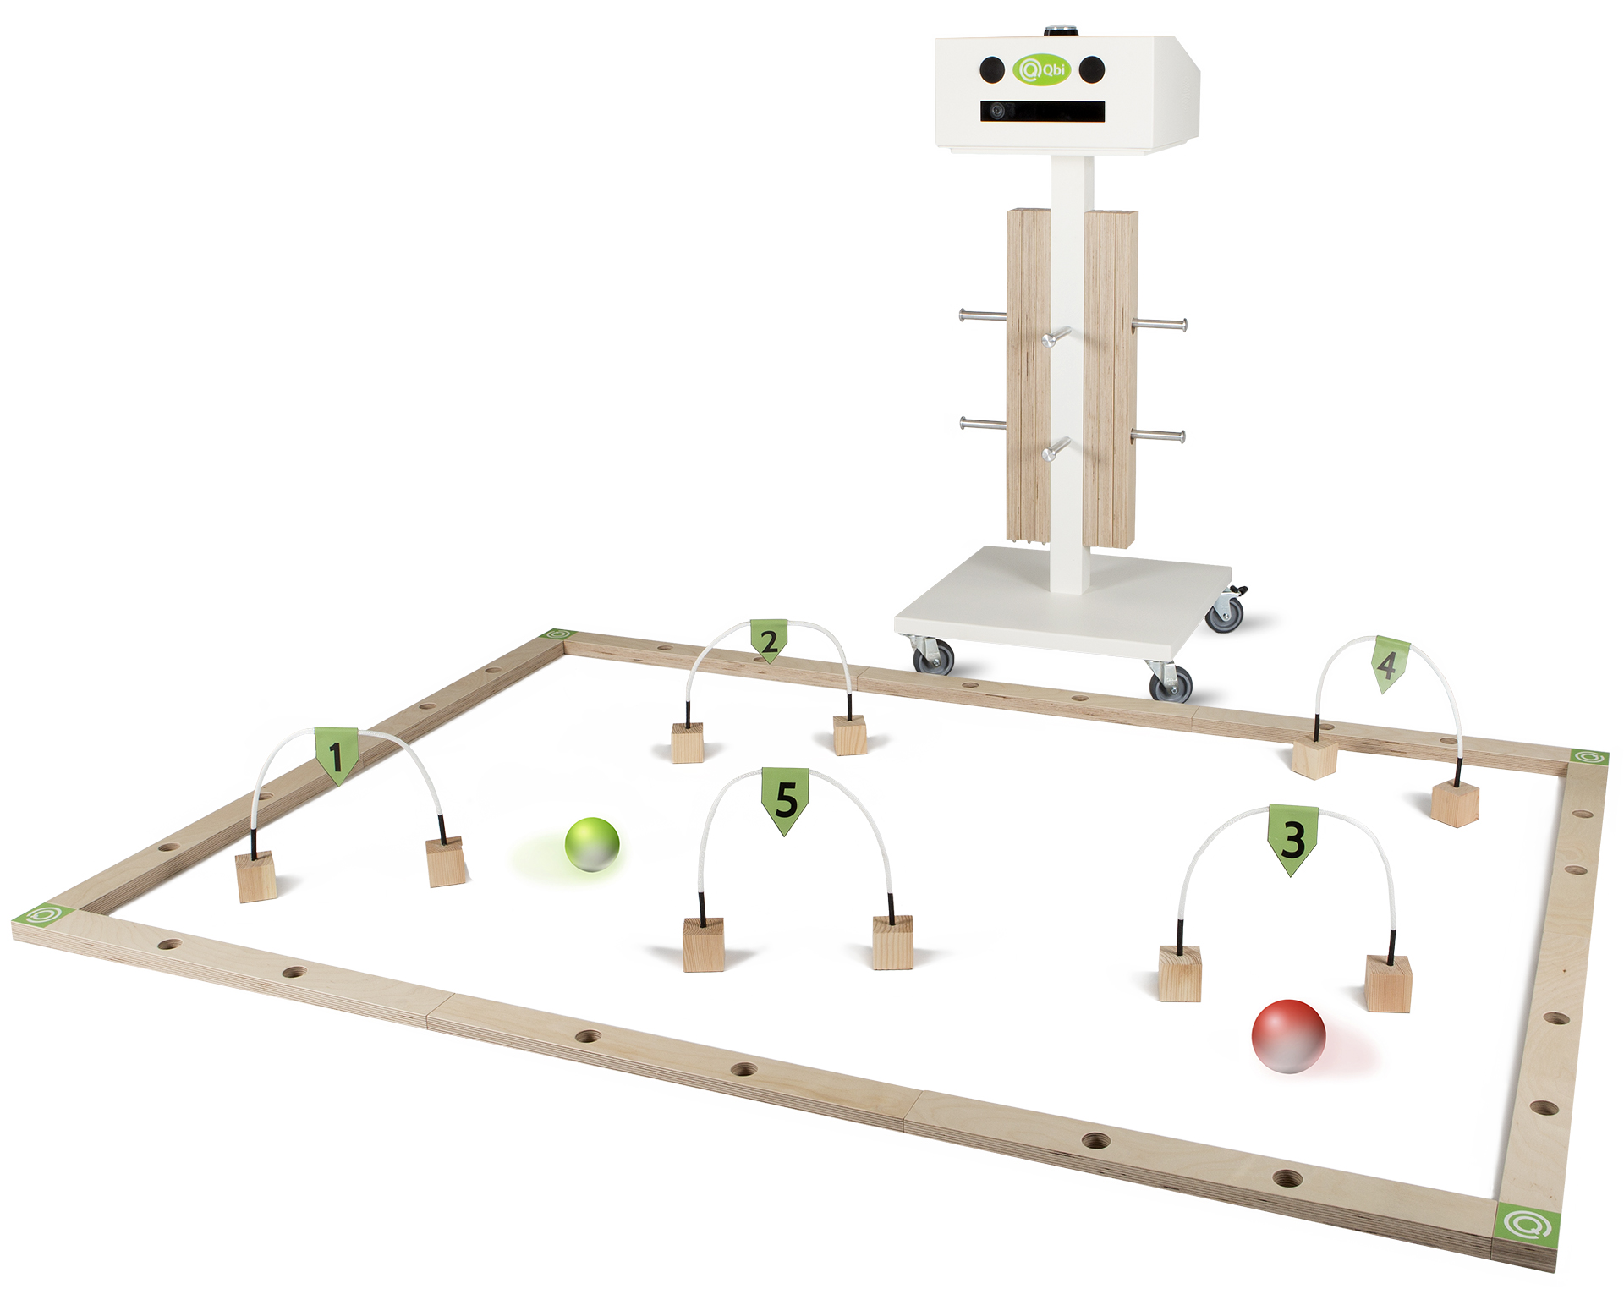
Which is good! Both Qbi and Zora can be used to stimulate a group of clients to move more.
‘I’m Zora and I can be uses to help your client move. I can perform various dances and movement excersises. I can also play games with you. I am uses by care organizations in group activities’.
‘I am Qbi. You can indeed use me to make your clients more active. The ball responds to body movements. The ball starts rolling by moving your hips. Do you get the ball through the gate!’
B
C

Slide 9
4
How would you get started with meaningful robotics within your organization?
A
That Qbi seems a bit like me! This robot fits well within our policy to move more. I ask the manager to order 5.
I make an invitory of the care we provide. I also pay attention to times where we can use some extra support. This is how I look for a good match.
Robots? I do not want that in our organization! My work will soon become redundant.
B
C

Slide 10
B
Very well! By assuming the care that you provide, instead of the robot you want to deploy, the chances are that your robot will be put to good use. For example, ik helps to draw your ideal robot for a specific purpose. Is one of the existing robots near your ideal robot? Or are there other solutions that might be better suited? For a meaningful use of robotics it is important to try out the robot to see if it contributes to the goal you have in mind and whether your client has a click with the robot.

Slide 11
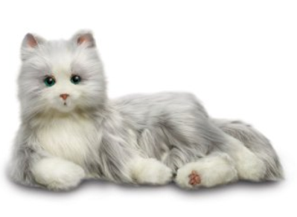
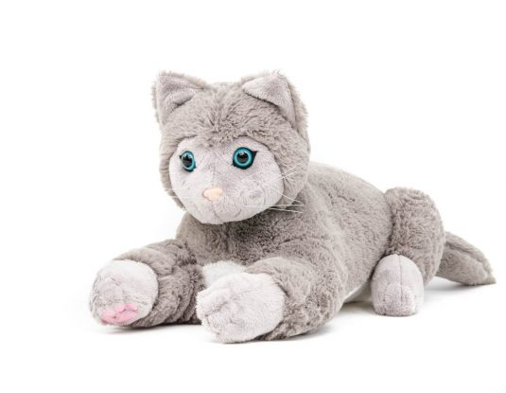
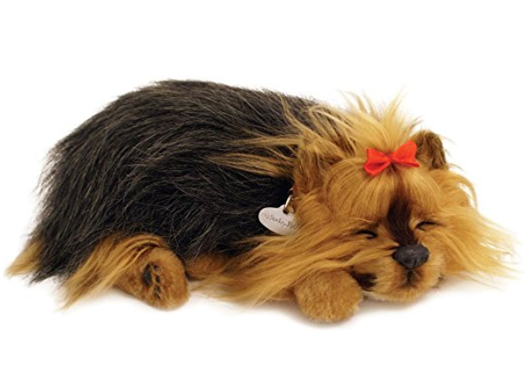
5
You are looking for companion type rotobs for the location where you work. The robot will come to lie in the common room. Which robot fits best?
Amazon Robotkat Robot JustoCat Amazon Robothond
A
B
C

Slide 12
Right! JustoCat can, in contrast to the other two robots, be washed in the washing machine. This is therefore more hygienic for use in groups. However, there is a balance to be made, trough options and costs.
‘I’m the JustoCat, I spin, vibrate and make sounds. I am a little bigger than the other robot cat, but I am more expensive and I move less.’
B
Cuddle robots can have different effects on your client. They can ensure that your client calms down or just revives; less anxious and / or confused; feels less lonely and / or depressed; recalls memories from the past; make more and better contact with his environment.

Slide 13
6
Yes! You have found a suitable robot. How do you deal with it?
A
We agree that a group of colleagues is responsible for the maintenance of the robot.
One colleague takes responsibility. She knows everything about the robot and we can turn to her with questions.
We’ll take a look. If you want to use the robot, you can use it. We do not lay down rules for this.
B
C

Slide 14
A
Well answered! By making a group of colleagues responsible for the robot, you ensure that not all knowledge is dependent on one person.
It is important to make good agreements about:
A lending grid for serveral users
Cleaning the robot
Charging the robot
A permanent place fot the robot
Maintenance / repair of the robot

Slide 15
7
You also want to make your colleagues enthusiastic about the use of robots within your organizaion. How do you handle this?
A
I organize an afternoon at work about the use of robots in healthcare. I ask an expert of a supplier to give a presentation and a demonstration.
I check if a student can do an internship with us about robotics in healthcare. The student can indicate in his final presentation why a robot would suit our organization.
I contact a supplier asking if we can try the robot for a while.
B
C

Slide 16
A
B
All three answers are good! Choose a way that suits you and the organization.
Bij collecting information bout robots in healthcare, you could also provide a presentation yourself.
C

Slide 17
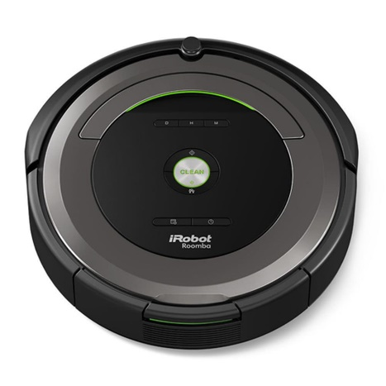
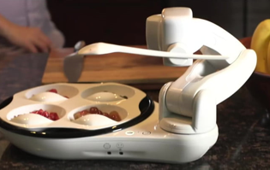
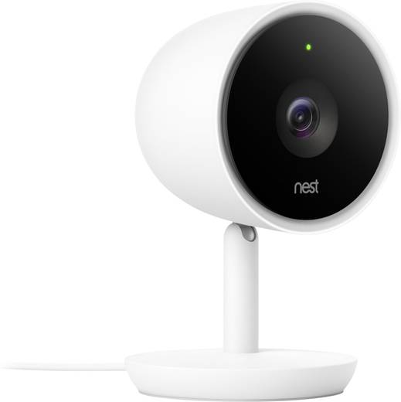
8
In addition to healthcare robots, there are also robots that can ensure that you can spend more time on healthcare by outsourcing other tasks to the robot. Which robot do you want to know more about?
Robot vacuum cleaner Robot arm Obi Nest IQ
A
B
C

Slide 18
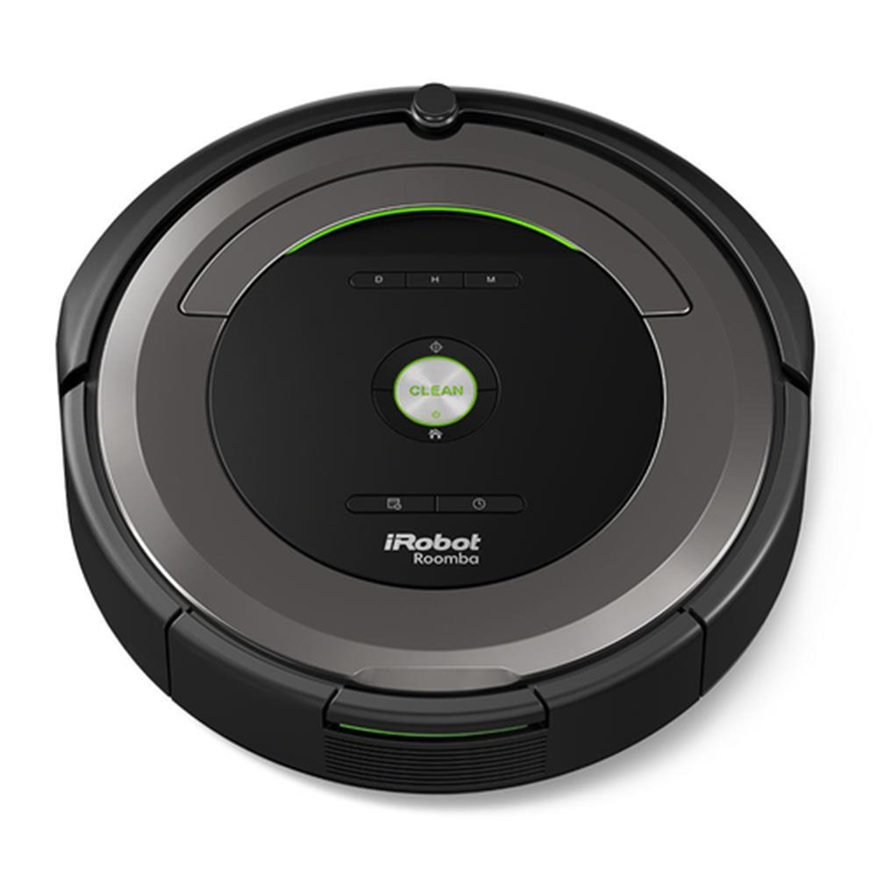
A
‘I am the robot vacuum cleaner. I independently vacuum the floor. I do not bump into furniture because of my sensors. You decide when to vacuum through setting a time. When I'm done I charge myself at my charging station.'

Slide 19
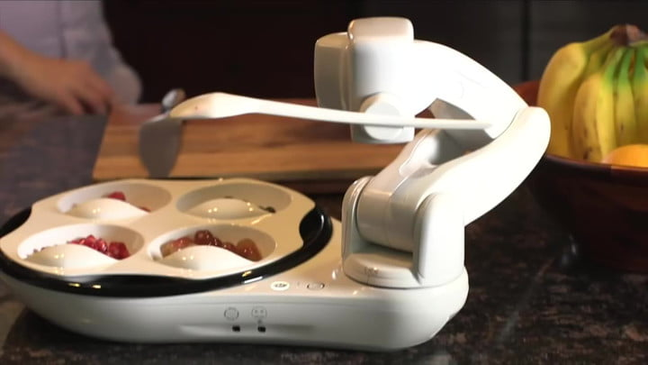
‘I am Obi. I help your client with food. With my robot arm I scoop up the food and bring it to my mouth. I am individually adjustable per person. You could also use me in rehabilitation care.'
B

Slide 20
'I am a Nest IQ robot. I have a camera function, which enables me to monitor. I have facial recognition, so I can specify when someone unknown comes in.’
You can link different options to Nest IQ. For example, a robot vacuum cleaner or a lamp with a sensor. The lamp turns on automatically when someone is around.
C
>> Bekijk het hier!

Slide 21
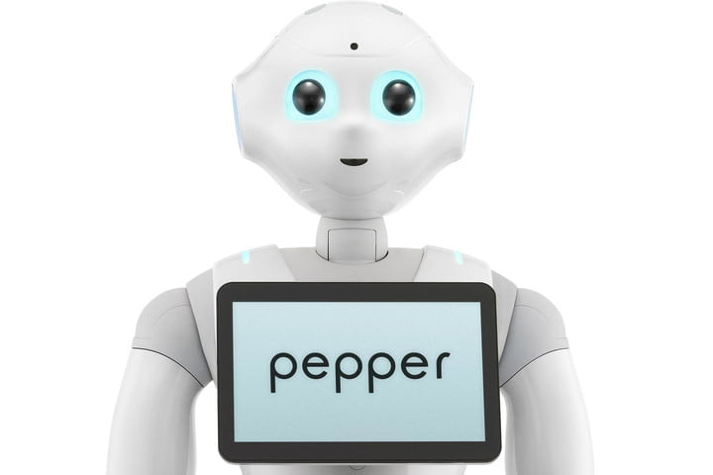
9
Some robots are suitable for one task, other robots can give you multiple tasks. These robots can often be programmed yourself. Which robot has multiple functions and is therefore not tied to one function?
Robot Tessa Robot Obi Robot Pepper
A
B
C

Slide 22
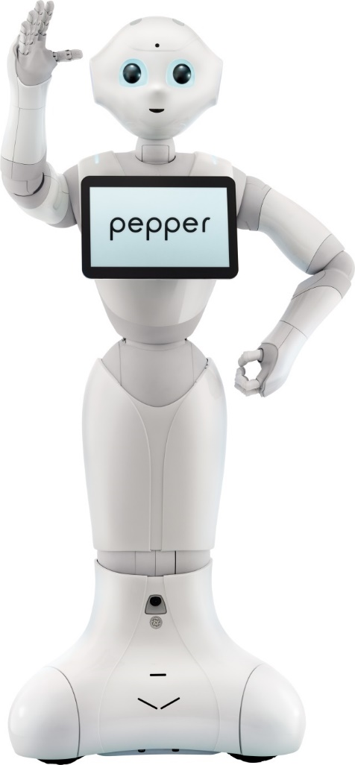
Good! You can look at the possibilities together with the supplier. The supplier can then program Pepper as desired.
‘I am Pepper. I am a social robot. I can talk and respond to answers.’
C
>> Bekijk het hier!

Slide 23


End of the Quiz
This quiz was made within the Care for Better Workplace Meaningful Robotics in Healthcare.

